Slide 1

Understanding Artificial Neural Networks

Slide 2
ANN
A large part of this section will focus on theory behind many of the ideas we will implement with code.
Let’s do a quick review of how we will gradually build an understanding of artificial neural networks.

Slide 3
ANN
Theory Topics
Perceptron Model to Neural Networks
Activation Functions
Cost Functions
Feed Forward Networks
BackPropagation

Slide 4
ANN
Coding Topics
TensorFlow 2.0 Keras Syntax
ANN with Keras
Regression
Classification
Exercises for Keras ANN
Tensorboard Visualizations

Slide 5
Let’s get started!

Slide 6
Perceptron Model

Slide 7
Perceptron model
To begin understanding deep learning, we will build up our model abstractions:
Single Biological Neuron
Perceptron
Multi-layer Perceptron Model
Deep Learning Neural Network

Slide 8
Perceptron model
As we learn about more complex models, we’ll also introduce concepts, such as:
Activation Functions
Gradient Descent
BackPropagation

Slide 9
Perceptron model
If the whole idea behind deep learning is to have computers artificially mimic biological natural intelligence, we should probably build a general understanding of how biological neurons work!

Slide 10
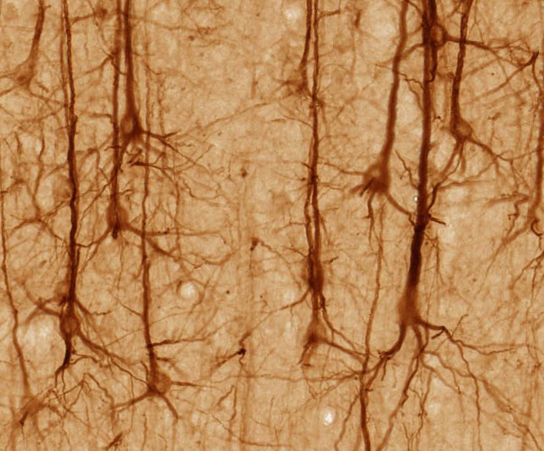
Perceptron model
Stained Neurons in cerebral cortex

Slide 11
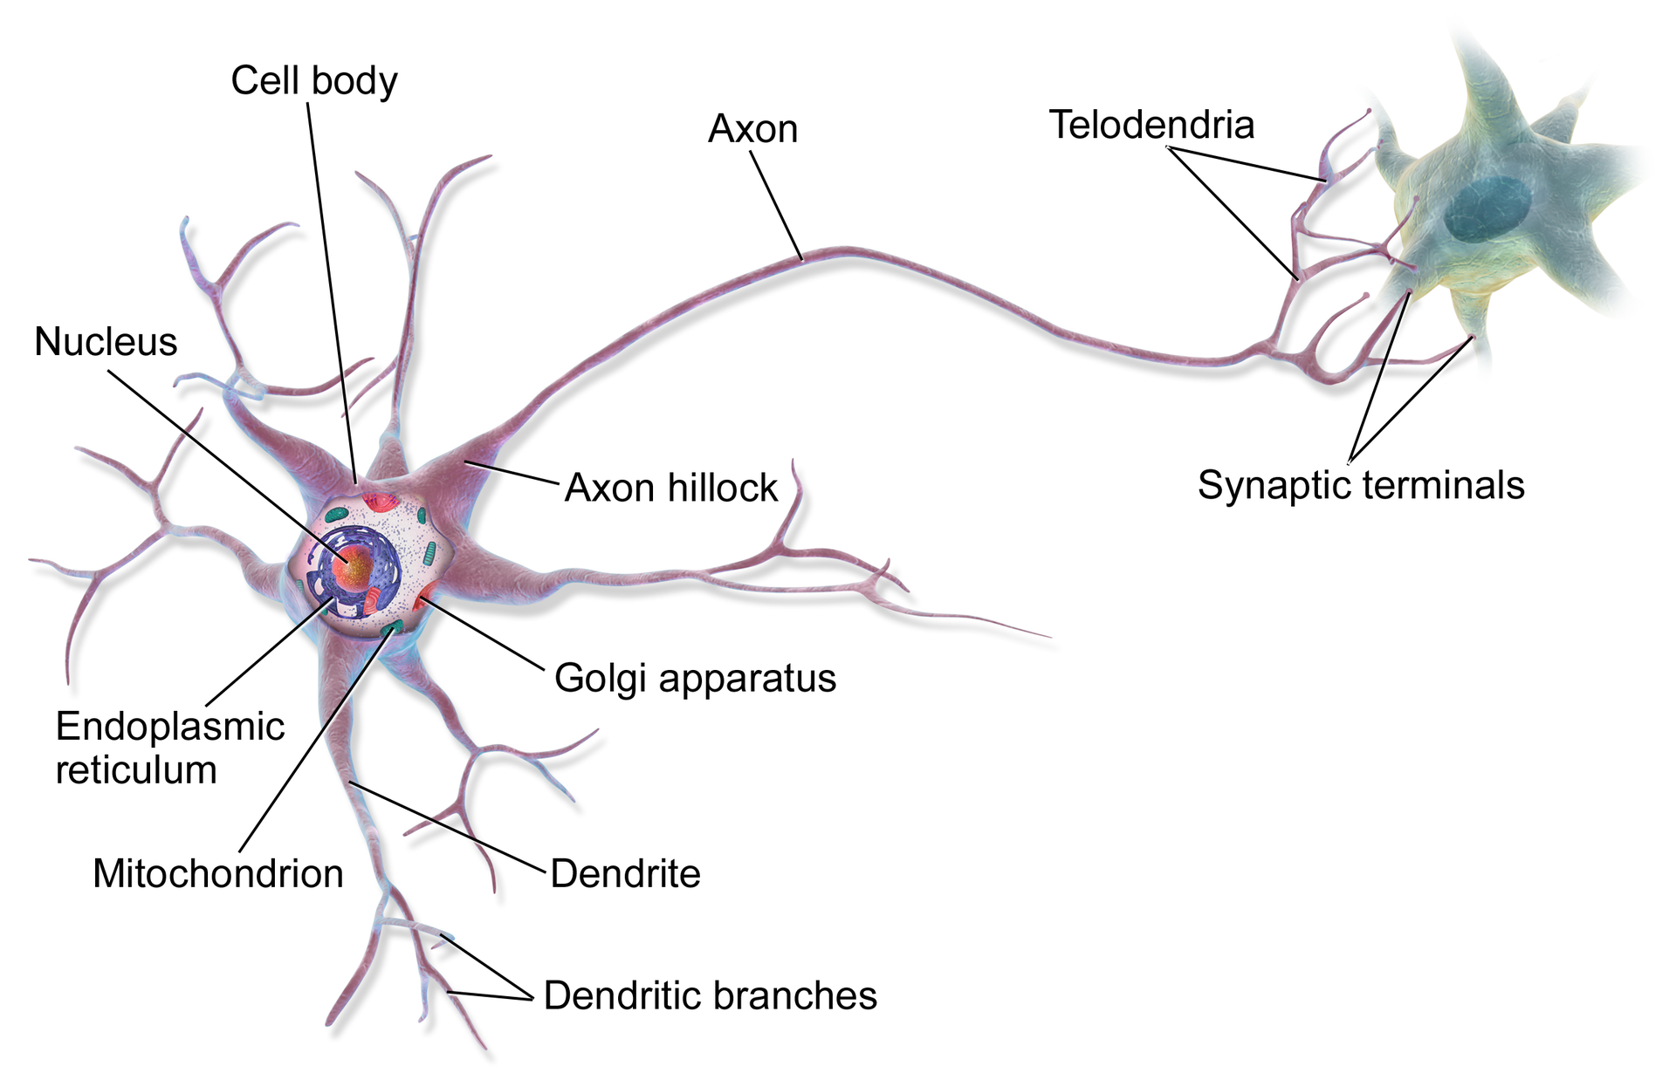
Perceptron model
Illustration of biological neurons

Slide 12
Perceptron model
Illustration of biological neurons

Slide 13
Perceptron model
Let’s really simplify this!

Slide 14
Perceptron model
Dendrites
Axon
Nucleus
Simplified Biological Neuron Model

Slide 15
Perceptron model
A perceptron was a form of neural network introduced in 1958 by Frank Rosenblatt.
Amazingly, even back then he saw huge potential:
"...perceptron may eventually be able to learn, make decisions, and translate languages."

Slide 16
Perceptron model
However, in 1969 Marvin Minsky and Seymour Papert's published their book Perceptrons.
It suggested that there were severe limitations to what perceptrons could do.
This marked the beginning of what is known as the AI Winter, with little funding into AI and Neural Networks in the 1970s.

Slide 17
Perceptron model
Fortunately for us, we now know the amazing power of neural networks, which all stem from the simple perceptron model, so let’s head back and convert our simple biological neuron model into the perceptron model.

Slide 18
Perceptron model
Dendrites
Axon
Nucleus
Perceptron Model

Slide 19
Perceptron model
Inputs
Output
Perceptron Model

Slide 20
Perceptron model
x1
Inputs
Output
x2
Let’s work through a simple example

Slide 21
Perceptron model
x1
Inputs
f(X)
Output
x2
Let’s work through a simple example

Slide 22
Perceptron model
x1
y
Inputs
f(X)
Output
x2
Let’s work through a simple example

Slide 23
Perceptron model
x1
y
Inputs
f(X)
Output
x2
If f(X) is just a sum, then y=x1+x2

Slide 24
Perceptron model
x1
y
Inputs
f(X)
Output
x2
Realistically, we would want to be able to adjust some parameter in order to “learn”

Slide 25
Perceptron model
w1
x1
y
f(X)
Output
Inputs
w2
x2
Let’s add an adjustable weight we multiply against x

Slide 26
Perceptron model
w1
x1
y
Inputs
f(X)
Output
w2
x2
Now y = x1w1 + x2w2

Slide 27
Perceptron model
w1
x1
y
Inputs
f(X)
Output
w2
x2
We could update the weights to effect y

Slide 28
Perceptron model
w1
x1
y
Inputs
f(X)
Output
w2
x2
But what if an x is zero? w won’t change anything!

Slide 29
Perceptron model
w1
x1
y
Inputs
f(X)
Output
w2
x2
Let’s add in a bias term b to the inputs.

Slide 30
Perceptron model
*w1 + b
x1
y
Inputs
f(X)
Output
x2
*w2 + b
Let’s add in a bias term b to the inputs.

Slide 31
Perceptron model
*w1 + b
x1
y
Inputs
f(X)
Output
x2
*w2 + b
y = (x1w1 + b) + (x2w2 + b)

Slide 32
Perceptron model
x1
*w1 + b
y
Output
Inputs
f(X)
x2
*w2 + b
xn
*wn + b
We can expand this to a generalization:

Slide 33
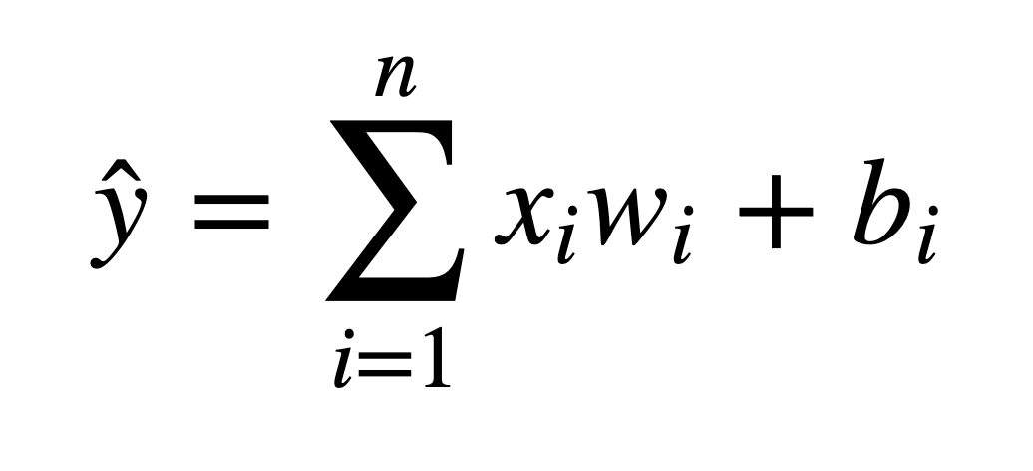
Perceptron model
We’ve been able to model a biological neuron as a simple perceptron! Mathematically our generalization was:

Slide 34
Perceptron model
Later on we will see how we can expand this model to have X be a tensor of information ( an n-dimensional matrix).

Slide 35
Perceptron model
Let’s review what we learned:
We understand the very basics of a biological neuron
We saw how we can create a simple perceptron model replicating the core concepts behind a neuron.

